Slide 1
Economic Advantages Through Strategic Coordination of Patent Protection at USPTO and Drug Approval at FDA
Betty R. Yu, M.S.
David K. Ho, Ph.D., J.D.
Harvest IP Law LLP

Slide 2
A. Background
B. Current Issues & Solutions
#1. Drug Development Timeline
#2. Effective U.S Market Protection
#3. Consistency at USPTO & FDA
C. Our World Under COVID
D. Conclusion
OUTLINE

Slide 3
A. Background
Patent Protection at USPTO Is Crucial
  Patent is the bedrock for all innovations.
  It prevents others from using the invention without licensing fee.
  Patent protection at the USPTO (U.S. Patent & Trademark Office) is important, because US is one of the leading jurisdictions in patent protection.

Slide 4
A. Background
Drug Approval at FDA Is Also Crucial
  The FDA (Food & Drug Administration) is responsible for protecting public health.
  FDA regulates human drugs and biological products, animal drugs, medical devices, tobacco products, food (including animal food), cosmetics, and electronic products that emit radiation.
  With FDA approval, the therapeutics and medical devices are allowed for sale.
  Small molecules - under Center for Drug Evaluation and Research (CDER).
  Biologics – under Center for Biologics Evaluation and Research (CBER).
  Medical devices – under Center for Devices and Radiological Health (CDRH).

Slide 5
A. Background
Reasons for the Current Challenges
  USPTO and FDA are different agencies.
  Patent attorneys (before the USPTO) and regulatory experts (before the FDA) are different types of professionals.
  Patents rights and drug exclusivity work in a similar fashion but are distinct from one another and governed by different statutes.
  Therefore, strategic coordination of patent protection and drug approval is critical – It requires a conscious effort!
  The result: either economic advantages or economic hardship.

Slide 6
A. Background
Patent Rights by USPTO
  Patents are a property right granted by the USPTO anytime during the development of a drug and can encompass a wide range of claims.
  Patent terms are set by statute.
  Currently, the term of a new patent is 20 years from the date on which the application for the patent was filed in the United States.
  Many other factors can affect the duration of a patent.

Slide 7
A. Background
Exclusivity by FDA
  Exclusivity is the exclusive marketing rights granted by the FDA upon approval of a drug and may run concurrently with a patent but need not do so.
  Exclusivity refers to certain delays and prohibitions on approval of competitor drugs available under the statute that attach upon approval of a drug or of certain supplements.
  A New Drug Application (NDA) [brand name drug] or Abbreviated New Drug Application (ANDA) [generic drug] holder is eligible for exclusivity if statutory requirements are met.

Slide 8
A. Background
Length of Exclusivity – Depends on the Type of Exclusivity at Issue:
  Orphan Drug Exclusivity (ODE) – 7 years. [Orphan diseases are rare: <200K]
  New Chemical Entity Exclusivity (NCE) – 5 years.
  Generating Antibiotic Incentives Now (GAIN) Exclusivity– 5 years added to certain exclusivities.
  New Clinical Investigation Exclusivity – 3 years.
  Pediatric Exclusivity (PED) – 6 months added to existing Patents/Exclusivity.
  Patent Challenge (PC) – 180 days (this exclusivity is for ANDA only).
  Competitive Generic Therapy (CGT) - 180 days (this exclusivity is for ANDA only).

Slide 9
A. Background
Stages of Name Brand Drug Development
  Step 1: Discovery & Development – biological activity, method of preparation
  Step 2: Preclinical Research – toxicity, safety
  Step 3: Clinical Research – selection of diseased and healthy volunteers
    Investigational New Drug (IND) application is required
    Phase 1 - 20 to 100 participants (several months)
    Phase 2 - several hundred participants (several months to 2 years)
    Phase 3 - 300 to 3,000 participants (1 to 4 years)
    Phase 4 - Several thousand participants
  Step 4: FDA Drug Review
  Step 5: FDA Post-Market Safety Review

Slide 10
A. Background
Generic Drugs – Why? What?
  In 1984, Congress passed the Hatch-Waxman Act, which catalyzed the creation of the modem generic drug industry.
  The main goal of this act to expedite the generic drug approval process and reach the market quickly at lower prices!
  A generic drug is a medication created to be the same as an already marketed brand-name drug in dosage form, safety, strength, route of administration, quality, performance characteristics, and intended use.
  These similarities help to demonstrate bioequivalence, which means that a generic medicine works in the same way and provides the same clinical benefit and therefore substitutes the brand-name medicine.

Slide 11
A. Background
Generic Drugs: How?
  Abbreviated New Drug Application (ANDA) is used for generic products approval in US. It comes under 505 (b)(j) section.
  Paragraph 1 Certification: when patent is not submitted for drug candidate (No Patent in Orange book). FDA can approve ANDA without delay.
  Paragraph 2 Certification: when the patent gets expired, FDA can approve ANDA without delay.
  Paragraph 3 Certification: After the particulate date when drug patent is going to be expired, FDA can approve ANDA.
  Paragraph 4 Certification: It is somewhat complicated. Applicant files the application to FDA for ANDA paragraph 4 certification. Applicant must notify the patent holder about this application within 20 days.

Slide 12
A. Background
Generic Drugs - More Details:
  Patent holder can file infringement suit against ANDA applicant within 45 days (from receiving of notification by ANDA applicant). Burden is on patent holder to start litigation.
  As a result, ANDA approval is stayed for 30 months. Patent holder gains an advantageous “breathing room”.
  It is important to note that 180-day exclusivity is only available to “First to File” (FTF) ANDA which comes successfully through Paragraph 4 certification. ANDA applicants are competing among themselves to be the first to file.

Slide 13
A. Background
Biologics at FDA
  Biologics are a wide range of products such as vaccines, blood, and blood components, allergenics, somatic cells, gene therapy, tissues, and recombinant therapeutic proteins.
  Biologics can be composed of sugars, proteins, or nucleic acids or complex combinations of these substances that are made from living cells.
  Biologic license application (BLA) is the process for FDA approval.
  Purple Book is the database containing all licensed biologic products.
  Biosimilars are follow-on products that are approved if they are shown to be “highly similar” to an already approved biologic innovator reference product.
  Biologic exclusivity is 12 years: 4 years before an application for a biosimilar may be submitted to the FDA, and 8 additional years before an application may be approved.

Slide 14
B. Current Issues & Solutions
#1. Drug Development Timeline
Drug discovery and development are both long and expensive.
Years of research; extreme challenge to design and synthesize drug candidates.
Discovery: 10,000 compounds (Q: Are the compounds biologically active?)
Preclinical: 250 compounds (Q: Are the compounds not toxic?)
Clinical trials: 5 compounds (Q: Are the compounds safe and effective?)
FDA approved drug: 1 compound (Q: Is the candidate approved?)

Slide 15
B. Current Issues & Solutions
#1. Drug Development Timeline
In 2022, for a new drug entering the market, the costs behind its approval averages US$2 billion.
In addition, the drug development process takes around 14 years of research and regulatory procedures before it is approved for sale.
Despite this massive investment, pharmaceutical companies and research institutes continue developing new drugs to save and improve lives.
In addition, brand name drug companies will face competition from generic drug companies.

Slide 16
B. Current Issues & Solutions
#1. Drug Development Timeline

Slide 17
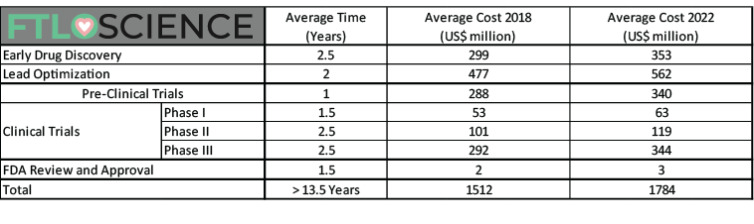
B. Current Issues & Solutions
#1. Drug Development Timeline
https://ftloscience.com/process-costs-drug-development/

Slide 18
B. Current Issues & Solutions
#1. Drug Development Timeline
Valley of Death
Translational medicine or translational science refers to the “bench-to-bedside” process that harnesses knowledge from basic scientific research into clinical research to create novel treatments.
However, this translation is full of obstacles.
Valley of death refers to the obstacles that are keeping innovative medical research discoveries from becoming new therapies or even making it to clinical trials.

Slide 19
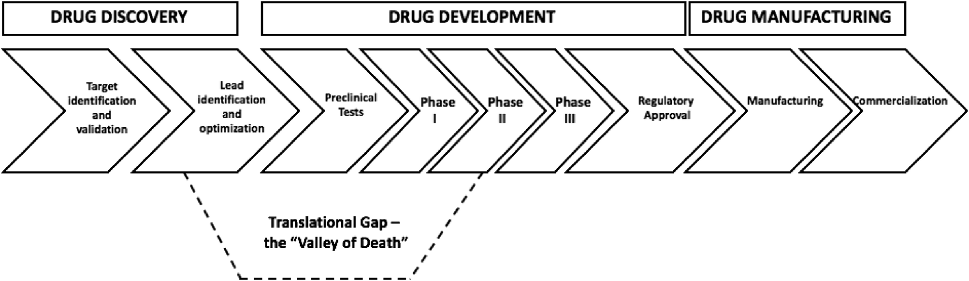
B. Current Issues & Solutions
#1. Drug Development Timeline

Slide 20
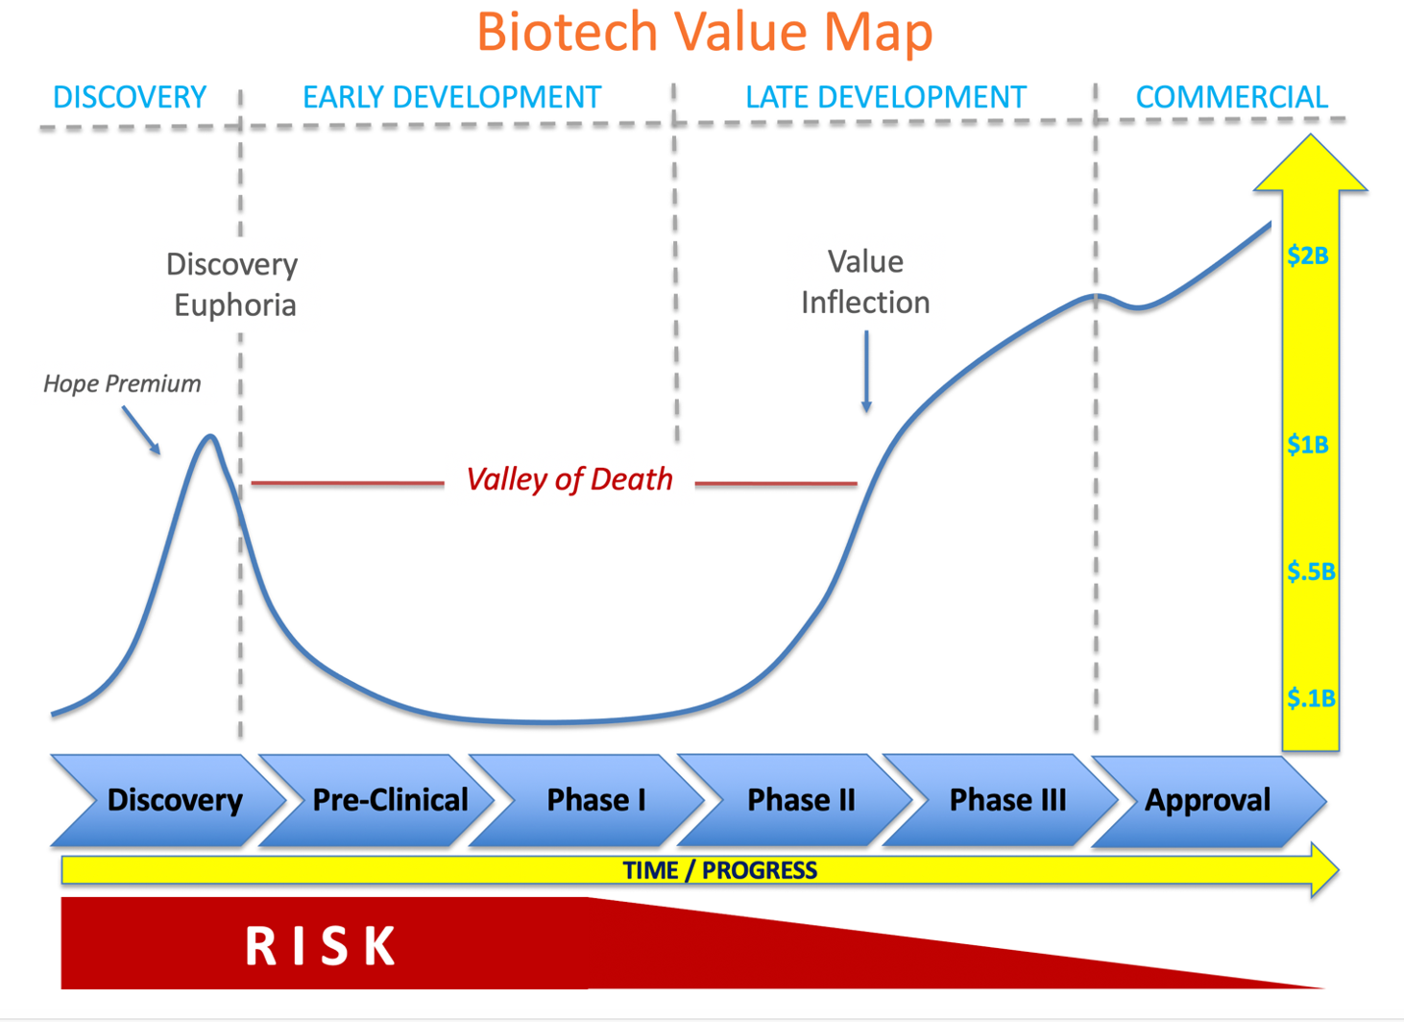
B. Current Issues & Solutions
#1. Drug Development Timeline
https://www.pharmexec.com/view/escaping-the-valley-of-death-the-funding-process-for-biotechnology-companies

Slide 21
B. Current Issues & Solutions
#1. Drug Development Timeline
Solutions: Valley of Death May be Overcome by:
  Impactful inventions that relate to cancer, high blood pressure, diabetes, Alzheimer’s, COVID, gene editing, gene therapy, vaccination, tissue regeneration, etc.
  Coordination of IP protection and regulatory
  Funding – Lots of it.

Slide 22
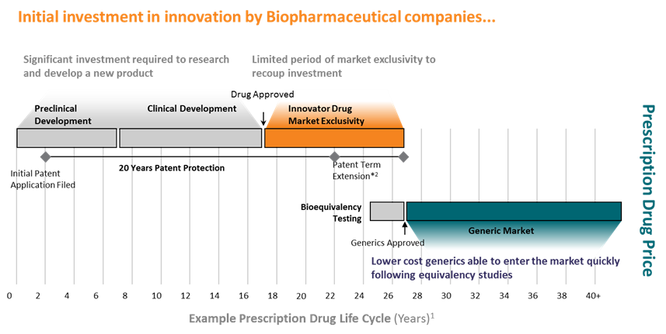
B. Current Issues & Solutions
#2. Effective U.S. Market Protection
https://www.efpia.eu/publications/data-center/medicines-costs-in-context/generic-medicines/

Slide 23
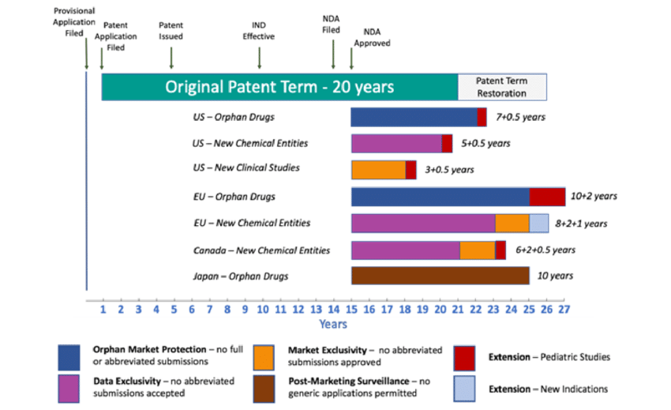
B. Current Issues & Solutions
#2. Effective U.S. Market Protection
https://www.researchgate.net/figure/Comparing-protection-against-competition-for-a-new-drug-sponsor-under-an-average_fig1_329452672

Slide 24
B. Current Issues & Solutions
#2. Effective U.S. Market Protection

Slide 25
B. Current Issues & Solutions
#2. Effective U.S. Market Protection

Slide 26
B. Current Issues & Solutions
#2. Effective U.S. Market Protection

Slide 27
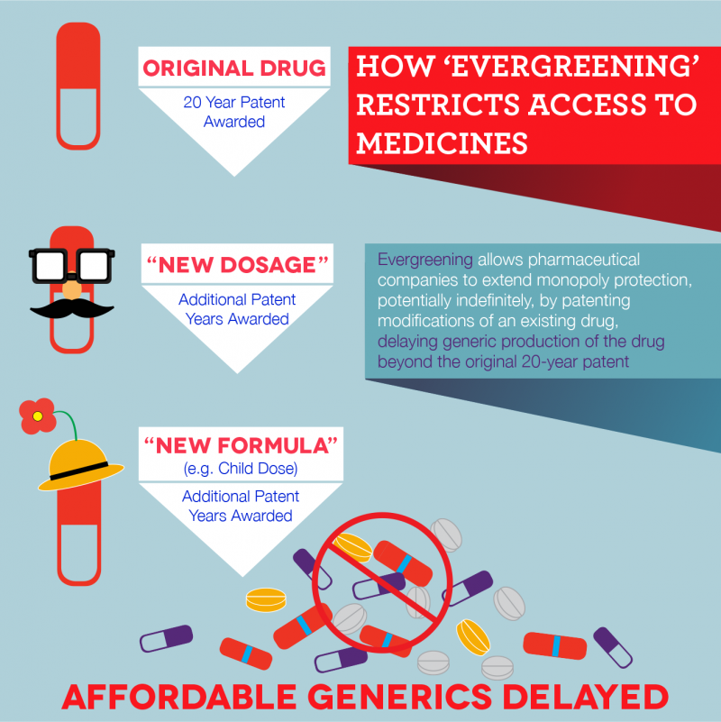
B. Current Issues & Solutions
#2. Effective U.S. Market Protection
Solutions
Extending original patents with patents on metabolites, new formula, or new dosages
This is advantageous to brand name drugs, but disadvantageous to generic drugs

Slide 28
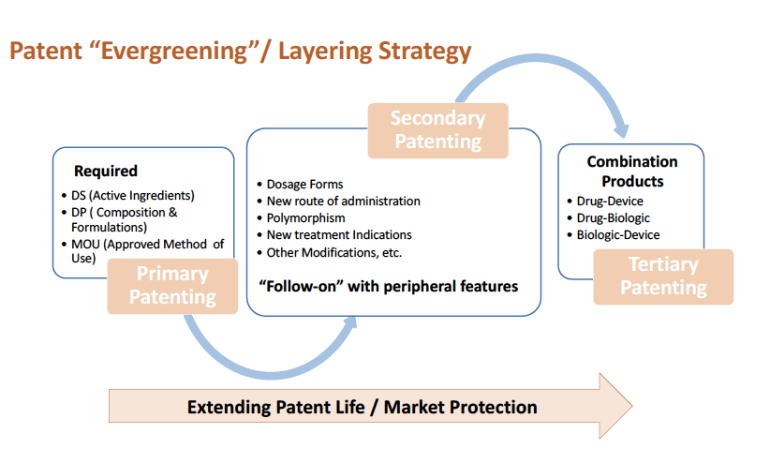
B. Current Issues & Solutions
#2. Effective U.S. Market Protection

Slide 29
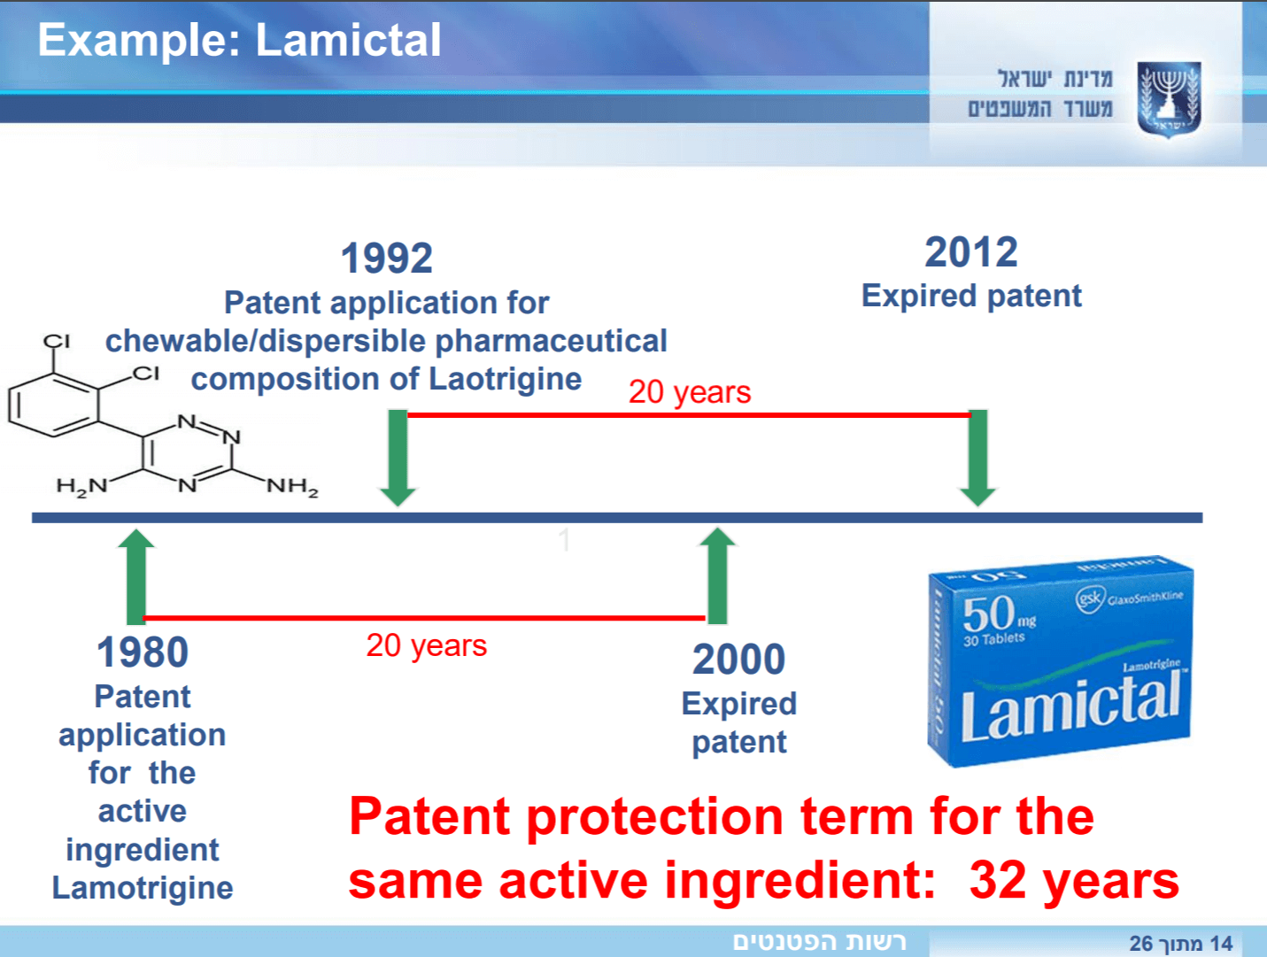
B. Current Issues & Solutions
#2. Effective U.S. Market Protection

Slide 30
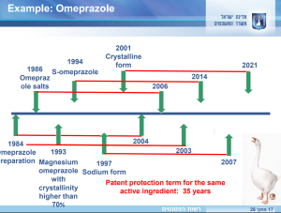
B. Current Issues & Solutions
#2. Effective U.S. Market Protection

Slide 31
B. Current Issues & Solutions
#2. Effective U.S. Market Protection
Harvest IP Law – Orange Book Analysis
This is a recently-added service at the firm.
It is a client-directed analysis of patents listed in FDA’s Orange Book.
The effective market protection of each drug will be calculated and analyzed. Actionable information is identified and strategized.
This is useful for both brand name drug and generic drug companies.
If interested, please contact Ms. Betty Yu (byu@harvestiplaw.com).
Sample Analysis: Boehringer Ingelheim’s OFEV (N205832) (Nintedanib) that is used for treatment of lung fibrosis (interstitial lung disease).

Slide 32
B. Current Issues & Solutions
#2. Effective U.S. Market Protection
Harvest IP Law – Orange Book Analysis - Example

Slide 33
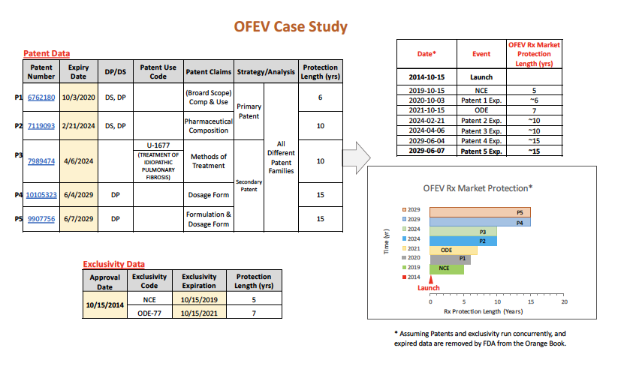
B. Current Issues & Solutions
#2. Effective U.S. Market Protection
Harvest IP Law – Orange Book Analysis - Example

Slide 34
B. Current Issues & Solutions
#2. Effective U.S. Market Protection
Harvest IP Law Orange Book Analysis - Summary
OFEV (N205832) is analyzed according to each patent’s subject matter.
Primary Patents: Drug Substance (DS) [active pharmaceutical ingredient API], Drug Product (DP) [composition/formulation], and Method of Use (MOU)
Secondary Patents: follow-on peripheral features such as dosage form, polymorphism, new treatment indications.
OFEV launch: 2014-10-15 >> NCE Excl: 2019-10-15 >> Patent 1: 2020-10-3
>> Orphan Drug Excl: 2021-10-15 >> Patent 2: 2024-02-21
>> Patent 3: 2024-04-06 >> Patent 4: 2029-06-04 >> Patent 5: 2029-06-07
From “Launch” to “Patent 5” = almost 15 years!

Slide 35
B. Current Issues & Solutions
#3. Consistency before USPTO & FDA
Issue 3A – Withholding Information from USPTO
  In Belcher Pharmaceuticals, LLC v. Hospira, Inc., Appeal No. 2020-1799 (Fed. Circ. Sept. 1, 2021)
  Patent owner held contradictory positions before the USPTO and the FDA. The material information included a journal article and similar formulations.
  The patent owner had told the FDA that racemization of the drug – a consideration in formulation – was a “well-known process,” citing the journal article, but this article was withheld from the USPTO.
  The patent owner had also characterized to the FDA that an in-process pH change as a “very minor change” compared to the manufacturing process for one of the two formulations, but this information was not disclosed to the USPTO.
  Therefore, Federal Circuit Court affirmed that the asserted patent was unenforceable because the patent owner had withheld material information from the USPTO with a deceptive intent.

Slide 36
B. Current Issues & Solutions
#3. Consistency before USPTO & FDA
Issue 3B: Interplay Between FDA Regulation on Medica Device and Patent Law at USPTO
  USPTO requires that an invention be novel and non-obvious (inventive step).
  At FDA, most medical devices are cleared through 510(k) submission by establishing similarity to a preexisting device (the “predicate” device) on the market.
  Problem #1 - The predicate device could be prior art reference against the patent application of the new medical device.
  Problem #2 – The filing of the 510(k) submission by the new medical device could be an admission of infringement on the predicate device.

Slide 37
B. Current Issues & Solutions
#3. Consistency before USPTO & FDA
Solution 3A
  Understand importance of holding consistent legal positions at USPTO and FDA.
  Entire brand name drug company must take information sharing seriously.
  Filing Information Disclosure Statement (IDS) must be coordinated by the patent counsel and the regulatory counsel.
Solution 3B
  If a predicate device is known during the pendency of the patent application of the medical device, such information must be disclosed as an IDS.
  Medical device company should focus on the safety and efficacy of the device when submitting the 510(k) application and may choose a predicate device that is not related to the subject matter of the patent application.

Slide 38
C. Our World Under COVID
Patent Landscape of COVID-Related Vaccines & Therapeutics
  2022 WIPO Report on all crucial patents for both vaccines and therapeutics.
COVID Vaccines
  The speed of COVID-19 vaccine development has been extremely fast (Operation Warp Speed), because of the worldwide pandemic.
  In USA, public and private entities united to fund development efforts.
  Billions of dollars from the government and nonprofits allowed development to take place unimpeded by cost constraints.
  Companies received funding from the government and federal agencies to cover manufacturing costs upfront.
  Millions of potential vaccine doses were created before they were approved, ensuring that FDA-approved vaccines would be distributed significantly faster.

Slide 39
C. Our World Under COVID
FDA Emergency Use Authorization (EUA) of COVID Vaccines:
  EUA means that the vaccine can be approved by the FDA quickly compared to a traditional FDA-approval process.
  Under EUA, clinical trial participants be followed for at least two months after vaccination (not six months under traditional FDA approval).
  Pfizer-BioNTech COVID-19 Vaccine (Comirnaty) (mRNA)
  Moderna COVID-19 Vaccine (Spikevax) (mRNA)
  Janssen (J&J) COVID-19 Vaccine (Jcovden) (DNA inside an adenovirus)
  Novavax COVID-19 Vaccine (Nuvaxovid and Covovax) (protein subunit)

Slide 40
C. Our World Under COVID
FDA Emergency Use Authorization of COVID Therapeutics
  Gilead Remdesivir (Veklury) – a repurposed antiviral drug
  Pfizer PAXLOVID (Nirmatrelvir co-packaged with Ritonavir)
  Eli Lilly Bebtelovimab (monoclinal antibody)
  AstraZeneca EVUSHELD™ (tixagevimab co-packaged with cilgavimab) monoclinal antibody

Slide 41
D. Conclusion
Before the COVID pandemic, drug regulation was a long process.
During the COVID pandemic, lightning speed regulatory approval was installed.
After the COVID pandemic, what about patents and drug approval?
We still face issues in funding, effective market protection, and consistency.
The Chinese word for “CRISIS” has two parts: “DANGER” and “OPPORTUNITY”.
Let’s hope that these challenges will lead to new opportunities: creative innovation, smarter thinking, and friendlier cooperation.
This conference on “IPR and Knowledge Driven Economy” is so crucial.

Slide 42
Thank You!
Harvest IP Law LLP
1455 Pennsylvania Avenue NW, Suite 400
Washington, DC 20004, U.S.A.
www.harvestiplaw.com

